Slide 1
Predicting the location of severe accidents in seattle
J. Papalia

Slide 2
Accident prediction
Accidents are destructive to both lives and property
The trickle-down effect of an accident can be felt across not only those directly involved in the accident, but those related to or affiliated with those involved
Being able to predict accident location – especially severe accidents – could lead to proactive actions meant to reduce accident probability

Slide 3
Data acquisition and cleaning
Data set provided by the class was used at first, but was found to be lacking in data with SEVERITYCODE of 2b and 3
Full data set was obtained from the Seattle GIS website
Data was cleaned to remove rows with missing data that could not be interpolated
Data was cleaned to better homogenize column values
Final data set contained 23 features

Slide 4
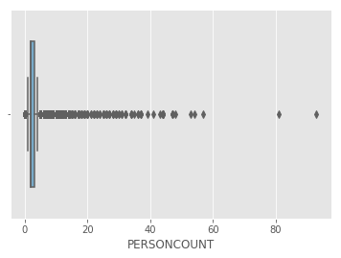
Visualization: Number of people involved in accident
Data is heavily skewed by “outlier” counts; it’s interpreted from the data that some of these higher values are caused by larger vehicles, such as buses, that are not broken out in the data.

Slide 5
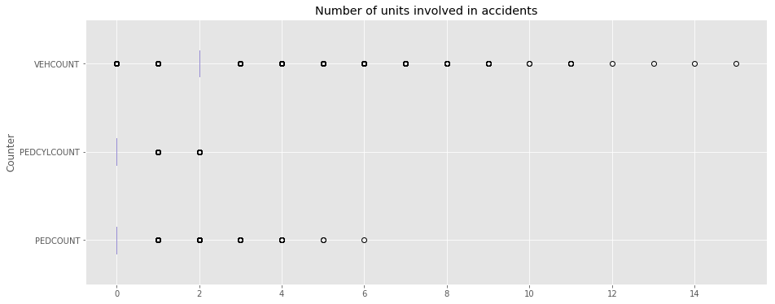
Visualization: Vehicles, bikes, and pedestrians

Slide 6
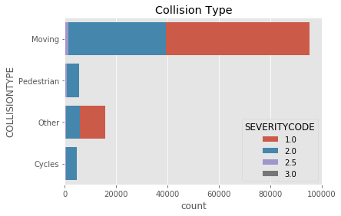
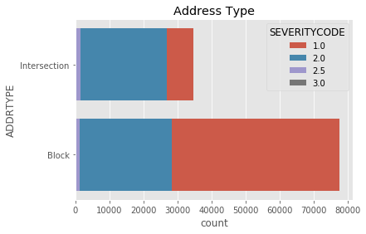
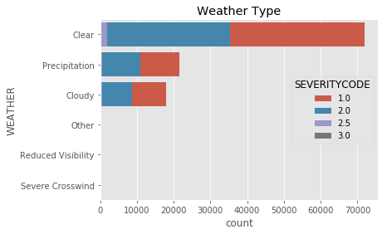
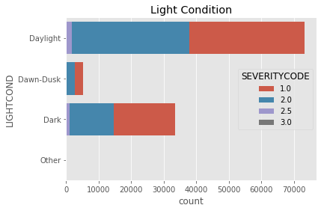
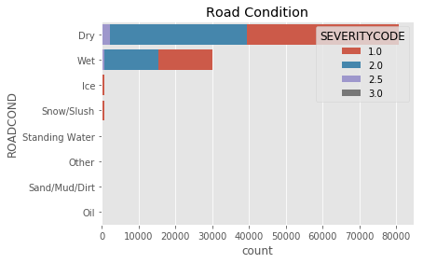
Breakdown: Severity versus various conditions

Slide 7
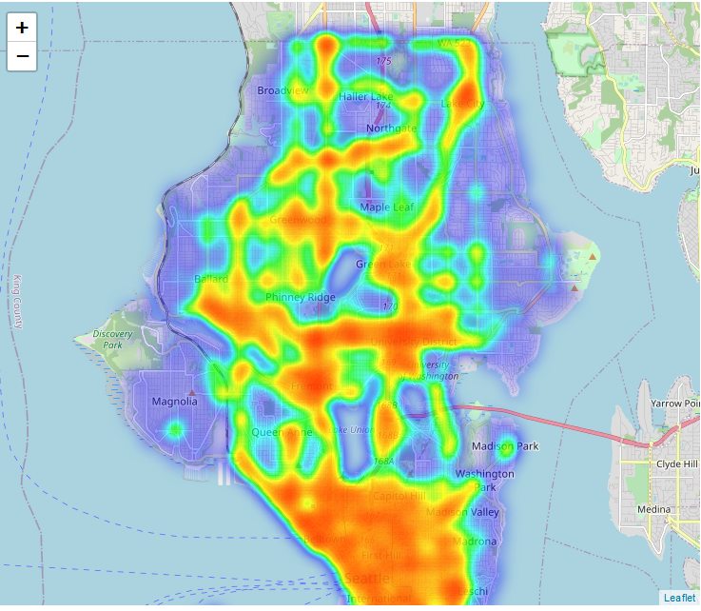
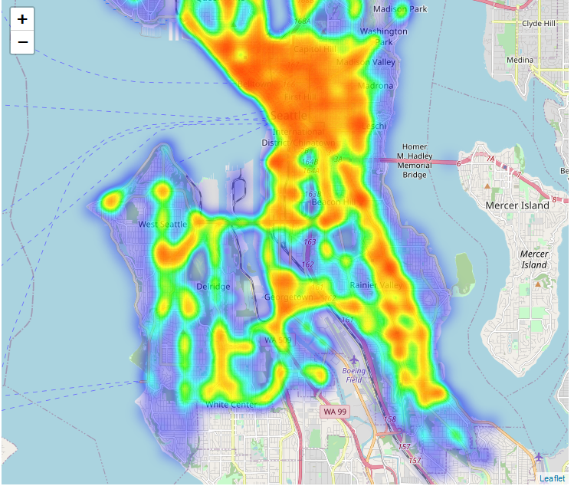
Heatmaps of all accidents (North and south seattle)
Map does not depict water areas well within the city limits

Slide 8
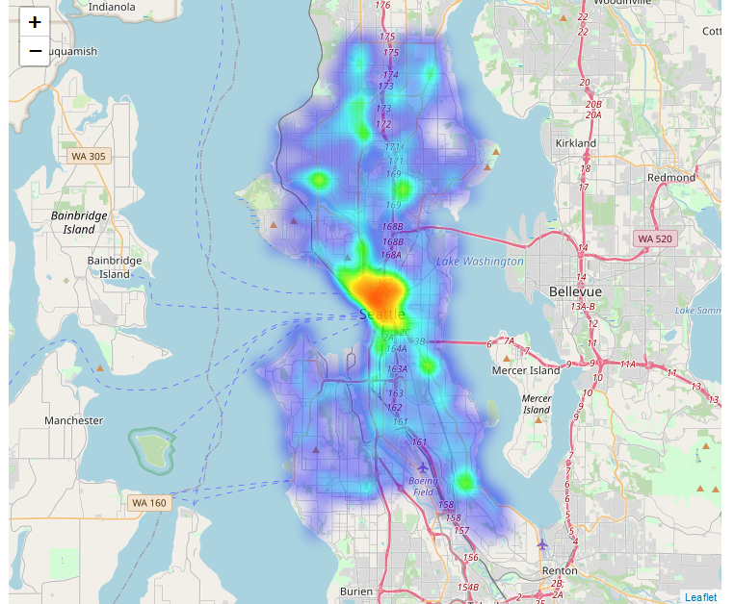
Heatmap of all severity 2b and 3 accidents Looks like center-city is dangerous

Slide 9
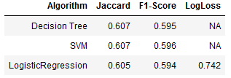
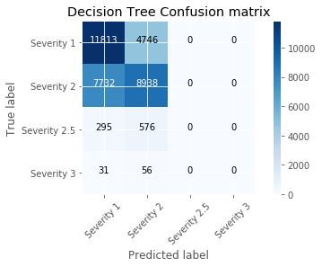
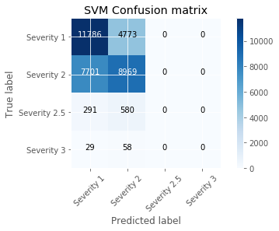
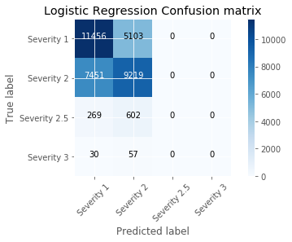
MODEL FITS

Slide 10
conclusions
Built models demonstrating the limitations of the available data set
Most of the limitation is caused by the much smaller occurrence of higher-severity accidents (it’s good that there are fewer severe accidents!)
Captures the traits of the environmental variables in an accident

